Slide 1





GANH’S TEAM
Project
Bootloader
Presentation

Slide 2





Meet Our Team
Tuan Bui
Son Pham
Bo Quang
Leader
Team member
Team member

Slide 3

Company Service
01
02
03
Working principle of Bootloader
Definition
Stored Bootloader
05
Function of
bootloader
06
Project Description

Slide 4

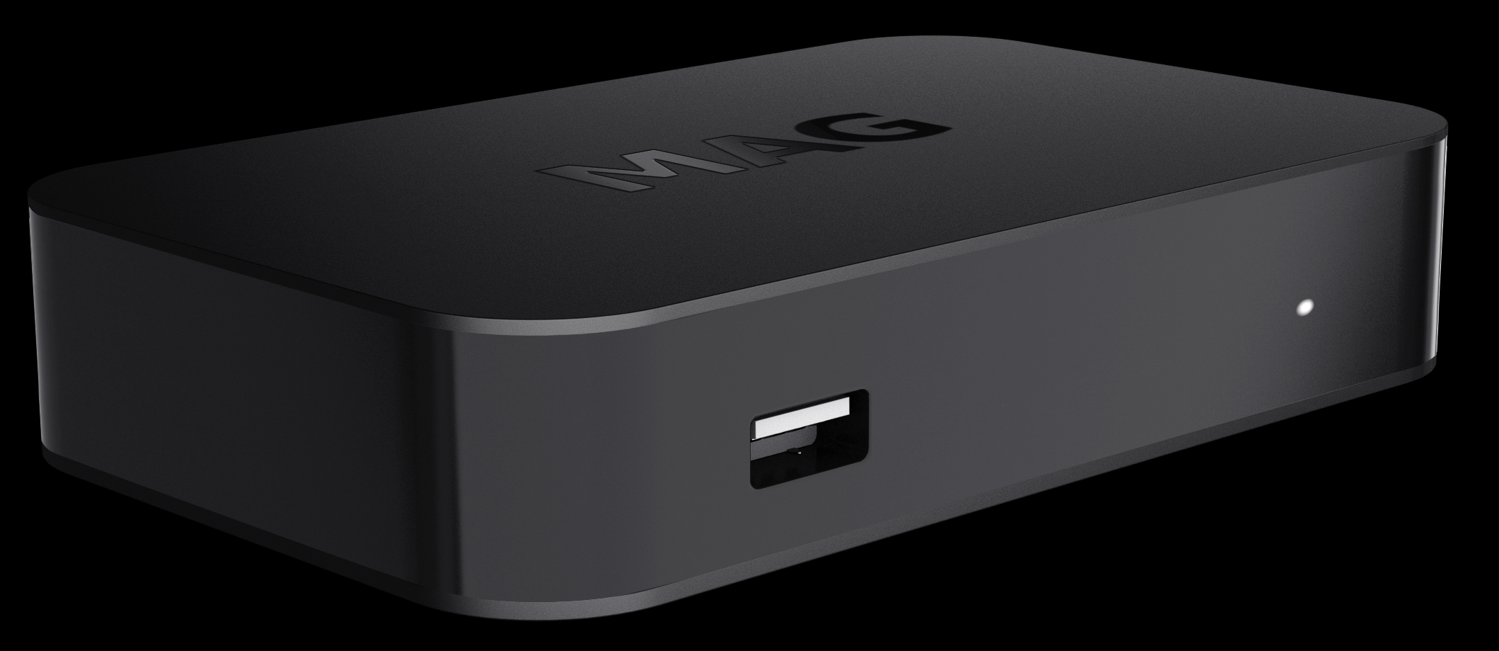

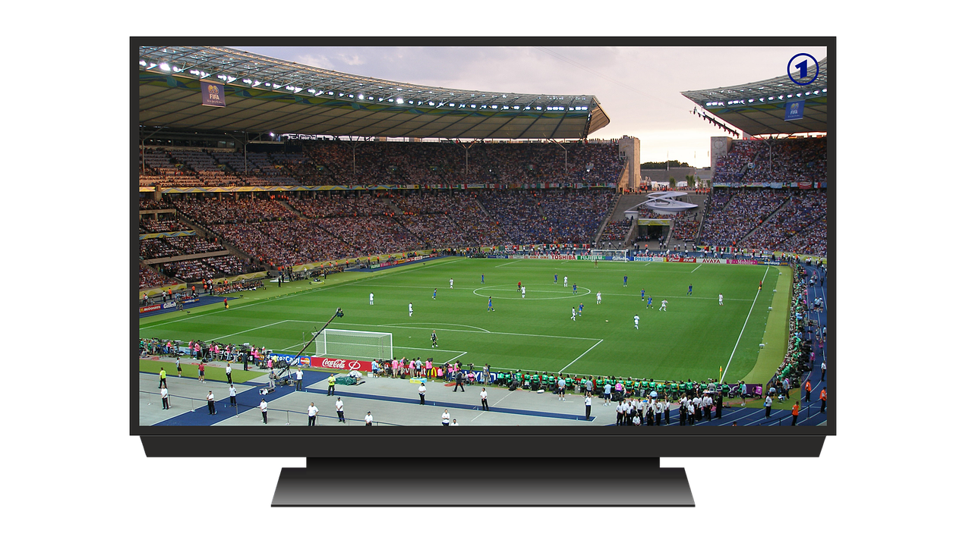
Does every sold unit need to be returned to the manufacturer every time there is a need for a firmware upgrade?
Microcontroller-based system is shipped with a bootloader on board

Slide 5
DEFINITION
- A bootloader is an application whose primary objective is to upgrade/modify system software without the intervention of specialized firmware upgrade tools.

Slide 6
Stored Bootloader
- Bootloaders can be stored in two different places:
The bootloader is stored in the first block of Flash.
The bootloader is stored on a specific partition memory region based on the structure as well as the purpose of developed software for the microcontroller.

Slide 7
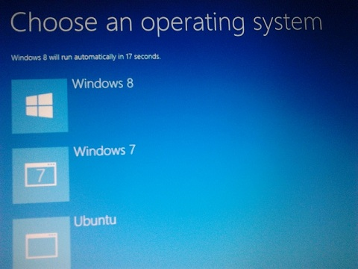
Working principle of Bootloader
- Windows operating system, if you press the Shift key or F12 key, then you may see one blue color screen with some options.

Slide 8
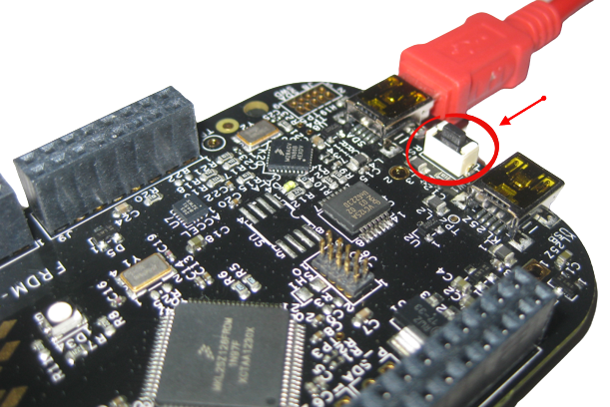
Working principle of Bootloader
This is the first piece of code that runs when you press the reset button if you have a bootloader.
If you don’t have a bootloader, then directly an application will start running
If you have a bootloader -> this bootloader starts running. ->control to the application.
=> The application does its job based on our product or project

Slide 9
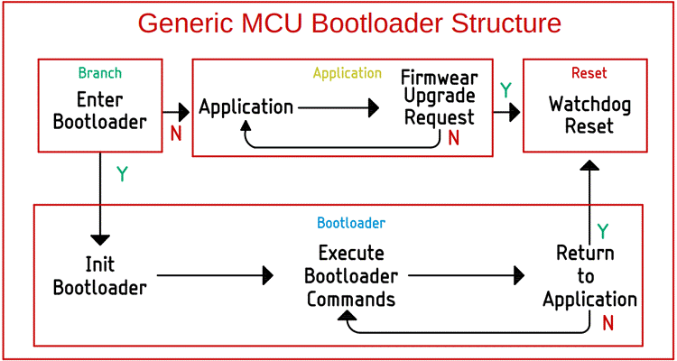
Function of Bootloader
1. Control and Manage the application
There are three crucial parts in any bootloader:
Branching code
Bootloader code
Application code.

Slide 10
Function of Bootloader
1. Control and Manage the application
Branching Code
Bootloader code
Application code

Slide 11
Function of Bootloader
1. Control and Manage the application
Branching Code
GPIO pin ?
Bootloader code
Application code

Slide 12
Function of Bootloader
1. Control and Manage the application
In a more complex system, the bootloader loads itself to the memory along with the application code, then it checks for initial parameters and system integrity.
-> Go back to executing the application code.

Slide 13
Function of Bootloader
2. Firmware upgrade
They can also utilize different protocols such as UART, CAN, I2C, I2S, Ethernet, or USB to establish communication and initial a firmware upgrade.
They also undergo above steps

Slide 14
Function of Bootloader
2. Firmware upgrade
Initializing basic instruction and peripherals
Bootloader loads into the memory
Accept instruction from outside
Upgrade process
Goes to the normal operation mode
Resets chip

Slide 15
Function of Bootloader
3. Check error code
Bootloaders can also perform checks on the higher-level code to make sure it’s not corrupted before loading it.

Slide 16
Function of Bootloader
4.Security
- ARM, who installs a separate “Zone of Trust” area, branded the ARM® TrustZone®.
- The bootloader would be accessible only by other software that has authorized access to that TrustZone, since ARM wants to segregate its critical operations from software and memory whose safety is not known
ARM® TrustZone®.

Slide 17
Project Description
1. Bootloader Hander
BUTTON 2 PRESS
Transfer SREC of FW1 and FW 2 to Flash memory
Erase Flash &Copy Vector table to RAM
Reset
BUTTON 2 NOT PRESS
FW1/2

Slide 18
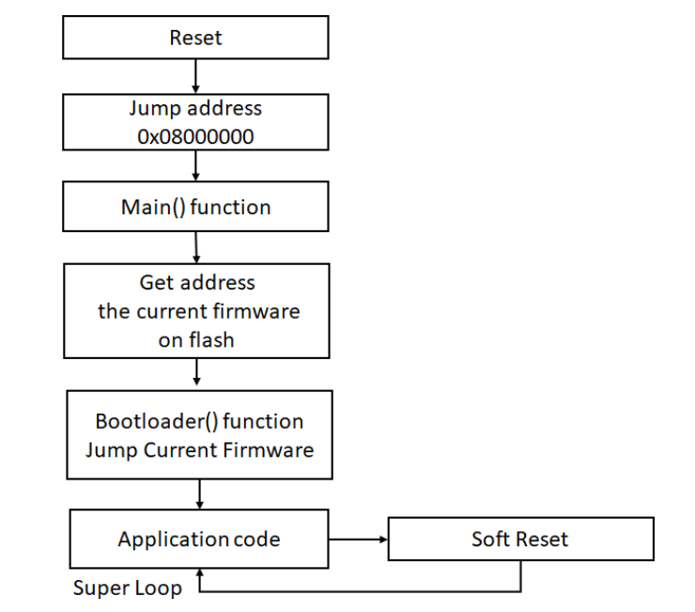
Project Description
2. Jumping Hander

Slide 19
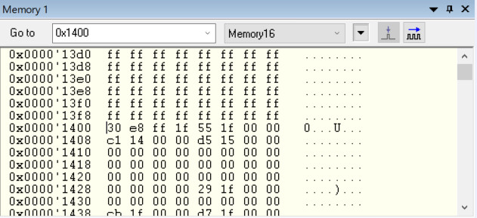
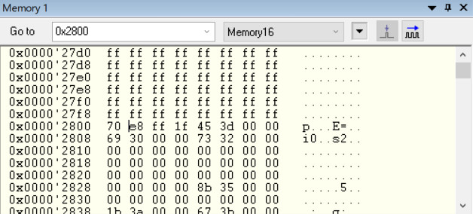
Project Description
3. Result
- Write to Flash
Firmware 1
Firmware 2

Slide 20
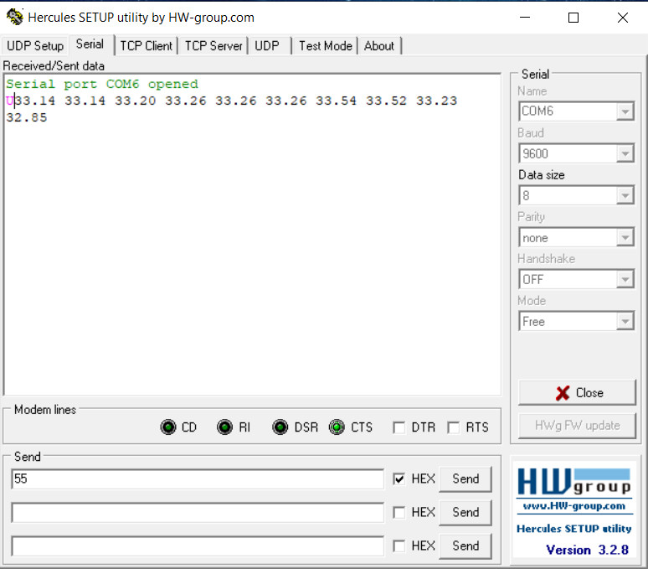
Project Description
3. Result

Slide 21
Project Description
3. Result

Slide 22

Thank
You

